Slide 1
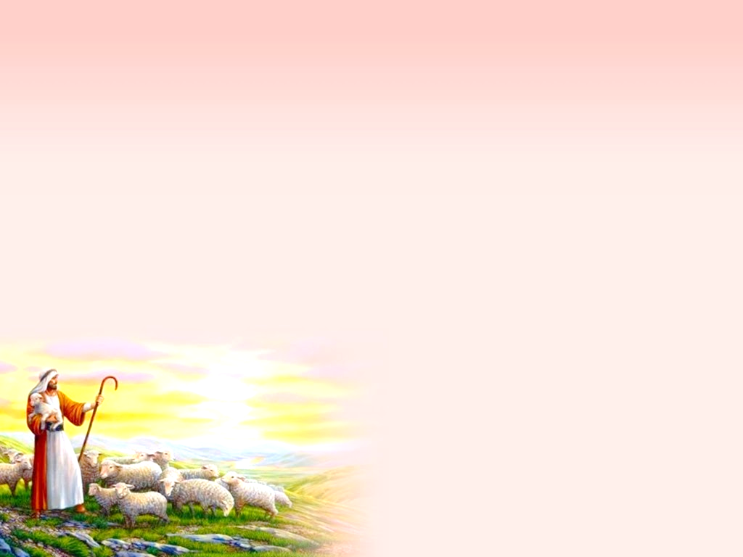
The Mission & Vision
of the Church

Slide 2
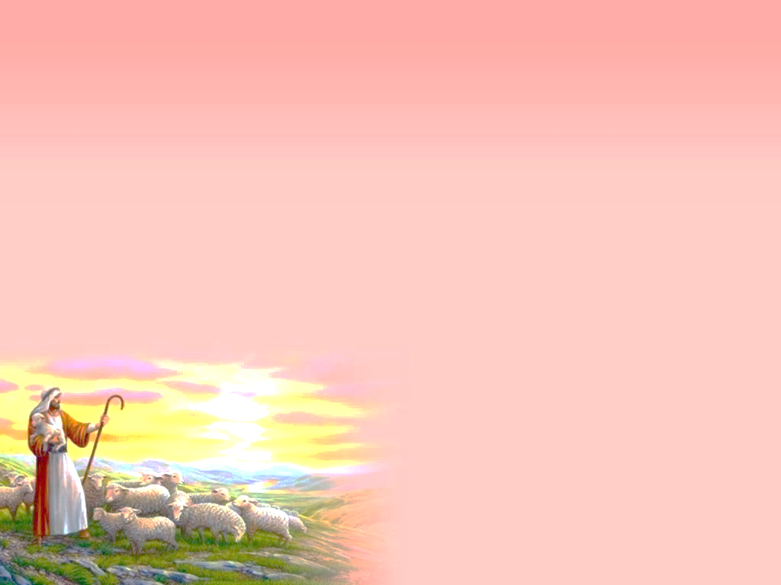
Reflection & Prayer
¹⁸ Where there is no vision, the people perish: but he that keepeth the law, happy is he. (Proverbs 29:18, KJV)
If people can’t see what God is doing, they stumble all over themselves; But when they attend to what he reveals, they are most blessed. MSG
Where there is no revelation, people cast off restraint;
but blessed is the one who heeds wisdom’s instruction. NIV

Slide 3
Our Objectives for this Workshop
Understand that we need to have a clear mission and vision
Scripture knowledge of the church’s mission and vision
Begin to think/renew about what the mission of Wheelock UMC is really about

Slide 4
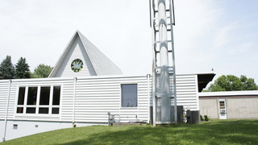
What is your church’s mission & vision
Do you know your church’s vision and mission?
Mission: "To Love, Nurture, Growth, and Witness in the name of our Lord Jesus Christ"

Slide 5
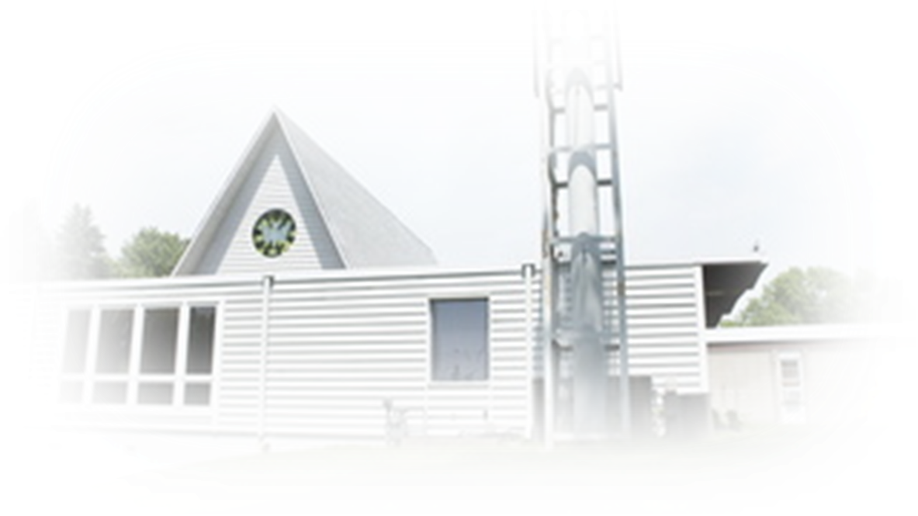
What is your church’s mission & vision
Vision: (values?, how?)
I. To be a LOVING congregation mean that we are committed ourselves to respecting, caring, sharing, helping, and visiting others. II. To be a NURTURING congregation mean we are committed to teaching, praising, communicating and leading others.

Slide 6
What is your church’s mission & vision
Vision:
III. To be a GROWING congregation mean we are committed to prayer, focusing for growth in membership through evangelism, advertising, and marketing the grace of God in our community. IV. To be a WITNESSING congregation mean we are committed to diversity, intercultural, and witness to all God's people here and around the world.

Slide 7
Our Challenges:
American Culture vs. Hmong Culture
The difference in understanding and adaptation to PLANNING, TIME, GOAL, WORK
The difference in understanding of leadership and adaptation to responsibilities: PASTOR and CHAIRPERSON

Slide 8
Our Challenges:
American Culture vs. Hmong Culture
Be conscious of the Society and Time we are in (driving culture, mindset, education, best practice)
Adaptation
Survival or growth
Best practice of church growth today

Slide 9
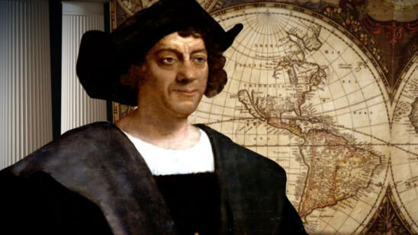
YOUR MUS HAVE A MISSION & MUST BE CLEAR
Christopher Columbus, 1490
Born in Agust 31 October 1451, died 20 May 1506) was an Italian explorer and navigator who completed four voyages across the Atlantic Ocean
Opened the way for the widespread European exploration and colonization of the Americas.
His expeditions, sponsored by the Catholic Monarchs of Spain, were the first European contact with the Caribbean, Central America, and South America.

Slide 10
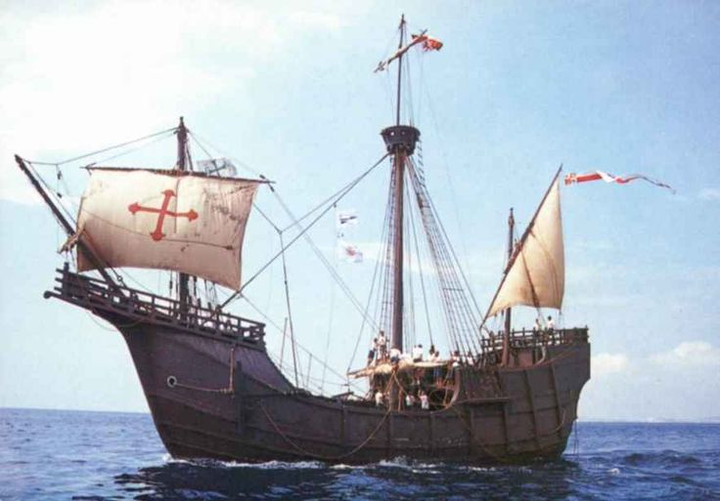
Setting the Sail (Mission)
Christopher Columbus, 1490
He developed a plan to seek a western sea passage to the East Indies, hoping to profit from the lucrative spice trade.
Columbus left Castile, Spain in August 1492 with three ships and made landfall in the Americas on 12 October, ending the period of human habitation in the Americas now referred to as the pre-Columbian era.
Christopher Columbus was named as the one who discovered America – Mission Accomplished

Slide 11
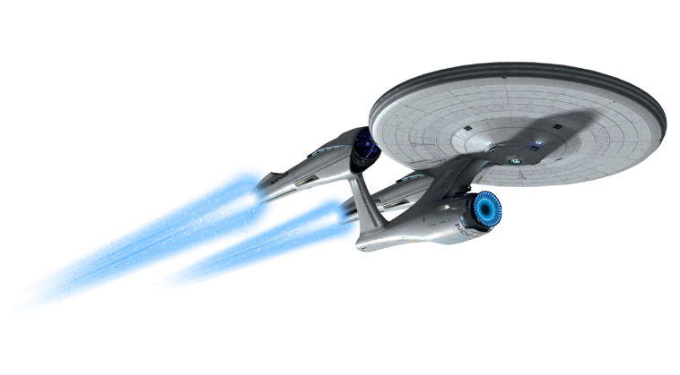
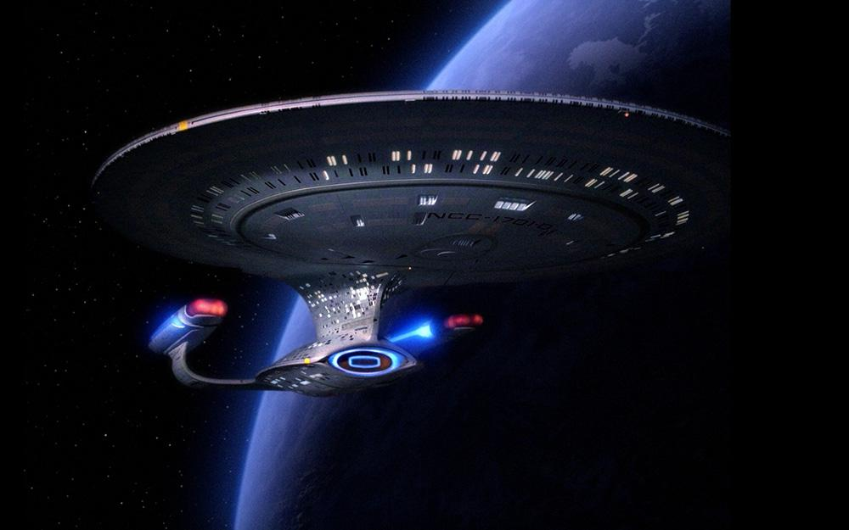
Setting the Mission
James T. Kirk & The Starship Enterprise
Under the command of Captain James T. Kirk, the Enterprise carries its crew on a mission "to explore strange, new worlds; to seek out new life and new civilizations; to boldly go where no man has gone before."
The Church needs to have a Mission/Vision. It must be clear and call for action. Why are we here? What do we need to do? Where are we going?

Slide 12
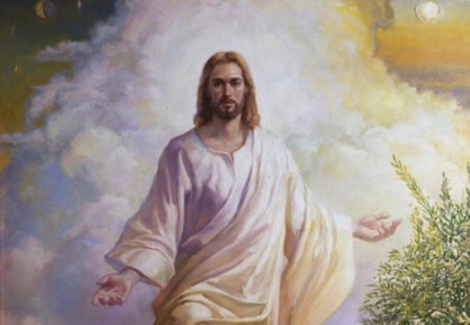
Mission & Vision of the Church
Jesus Christ, In His Incarnation-reason for coming
Mission:
John 3:16, For God so loved the world that he gave his one and only Son, that whoever believes in him shall not perish but have eternal life.
Birth, ministry, suffering, death, resurrection
Second coming and the full Kingdom of God

Slide 13
Mission & Vision of the Church
Jesus Christ, In His Incarnation
The Vision:
Matthew 28:16-20, “Then the eleven disciples went to Galilee, to the mountain where Jesus had told them to go. ¹⁷ When they saw him, they worshiped him; but some doubted. ¹⁸ Then Jesus came to them and said, “All authority in heaven and on earth has been given to me. ¹⁹ Therefore go and make disciples of all nations, baptizing them in the name of the Father and of the Son and of the Holy Spirit, ²⁰ and teaching them to obey everything I have commanded you. And surely I am with you always, to the very end of the age.”

Slide 14
Mission & Vision of the Church
Jesus Christ, In His Incarnation
The Vision:
Acts 1:8
⁸ But you will receive power when the Holy Spirit comes on you; and you will be my witnesses in Jerusalem, and in all Judea and Samaria, and to the ends of the earth.”
What is the characteristices of mission and vision?
It’s broad, it’s specific, it gives direction, it’s clear, complete
It is God’s Mission, the Disciple to carry on, what to do, to every nation and to the end of the earth.

Slide 15
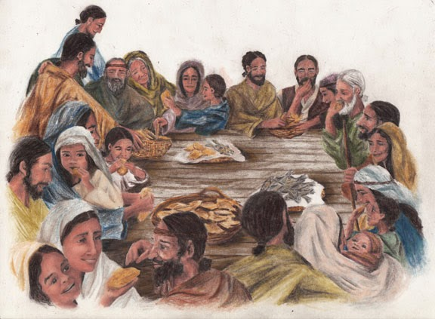
Mission & Vision of the Church
How the Early Church carried out God’s M&V
Acts 2:41-47 – The Beginning
“Those who accepted his message were baptized, and about three thousand were added to their number that day. ⁴² They devoted themselves to the apostles’ teaching and to fellowship, to the breaking of bread and to prayer. ⁴³ Everyone was filled with awe at the many wonders and signs performed by the apostles. ⁴⁴ All the believers were together and had everything in common. ⁴⁵ They sold property and possessions to give to anyone who had need. ⁴⁶ Every day they continued to meet together in the temple courts. They broke bread in their homes and ate together with glad and sincere hearts, ⁴⁷ praising God and enjoying the favor of all the people. And the Lord added to their number daily those who were being saved.
What was happening to the people who had come to believe in Jesus Christ?

Slide 16
Mission & Vision of the Church
How the Early Church carried out God’s M&V
Acts 8:14-17 – The Jerusalem Church
¹⁴ When the apostles in Jerusalem heard that Samaria had accepted the word of God, they sent Peter and John to Samaria. ¹⁵ When they arrived, they prayed for the new believers there that they might receive the Holy Spirit, ¹⁶ because the Holy Spirit had not yet come on any of them; they had simply been baptized in the name of the Lord Jesus. ¹⁷ Then Peter and John placed their hands on them, and they received the Holy Spirit….
²⁵ After they had further proclaimed the word of the Lord and testified about Jesus, Peter and John returned to Jerusalem, preaching the gospel in many Samaritan villages.
What was the responsibility of the Apostleship?
Who are the Apostles? Who are Peter and John?

Slide 17
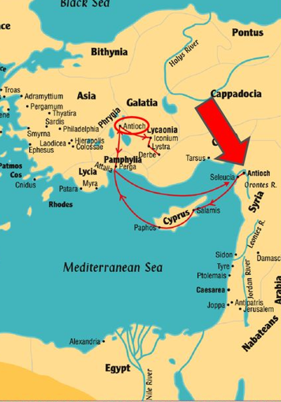
Mission & Vision of the Church
How the Early Church carried out God’s M&V
Acts 8:14-17 – The Antioch Church
¹ Now in the church at Antioch there were prophets and teachers: Barnabas, Simeon called Niger, Lucius of Cyrene, Manaen (who had been brought up with Herod the tetrarch) and Saul. ² While they were worshiping the Lord and fasting, the Holy Spirit said, “Set apart for me Barnabas and Saul for the work to which I have called them.” ³ So after they had fasted and prayed, they placed their hands on them and sent them off.
⁴ The two of them, sent on their way by the Holy Spirit, went down to Seleucia and sailed from there to Cyprus. ⁵ When they arrived at Salamis, they proclaimed the word of God in the Jewish synagogues
What can we tell about this church?

Slide 18
Mission & Vision of the Church
What were the mission and vision of the Early Church?
Fellowship together, at least weekly
Proclaiming the Good News of Jesus Christ
Breaking of Break and Drinking of the Cup
Sharing what they had, to one another & those in need
Selling what they had (sell possession and giving alms)
Gathering for worship, teaching and learning, prayers and fasting
Go from place to place/house to house
Commissioning people to serve as missionary/pastor
Supporting the works of the church
Go beyond your own race, town and country, etc.

Slide 19
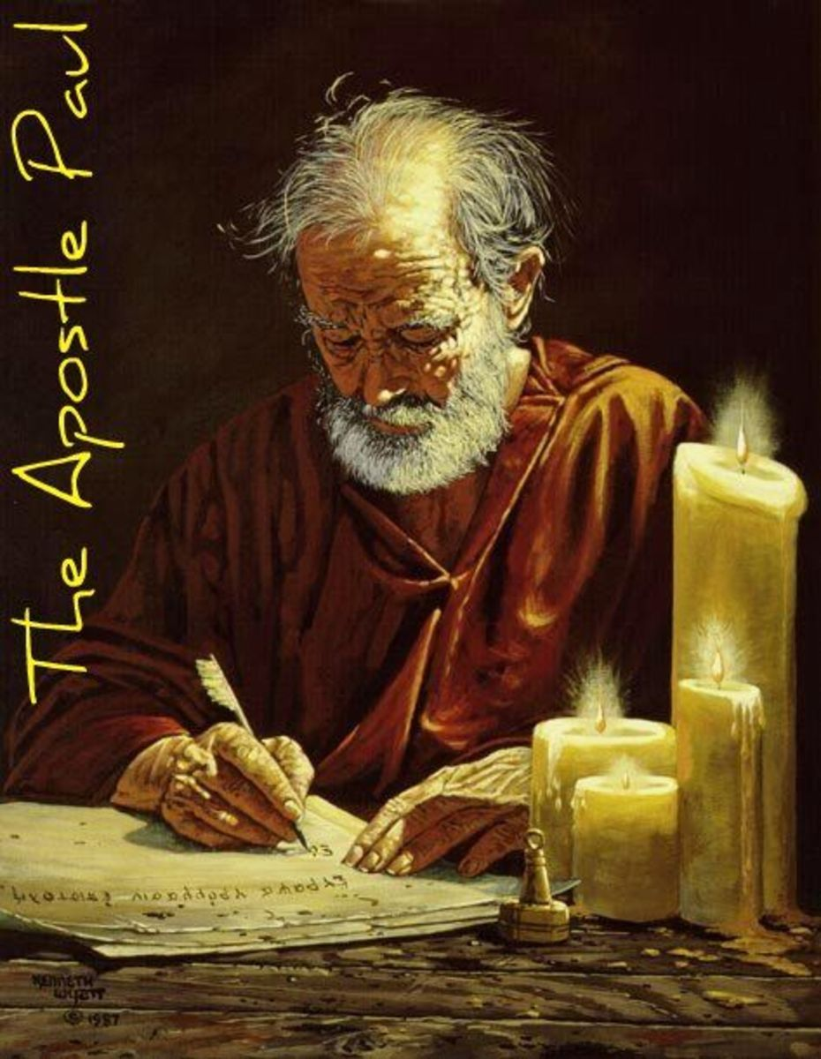
Mission & Vision of the Church
Strong Beliefs and Convictions
Romans 1:16-17
¹⁶ For I am not ashamed of the gospel, because it is the power of God that brings salvation to everyone who believes: first to the Jew, then to the Gentile. ¹⁷ For in the gospel the righteousness of God is revealed—a righteousness that is by faith from first to last,^{[e]} just as it is written: “The righteous will live by faith.”^{[f]}

Slide 20
Mission & Vision of the Church
Strong Beliefs and Convictions
Romans 10:9-13
⁹ If you declare with your mouth, “Jesus is Lord,” and believe in your heart that God raised him from the dead, you will be saved. ¹⁰ For it is with your heart that you believe and are justified, and it is with your mouth that you profess your faith and are saved. ¹¹ As Scripture says, “Anyone who believes in him will never be put to shame.”^{[e]} ¹² For there is no difference between Jew and Gentile—the same Lord is Lord of all and richly blesses all who call on him, ¹³ for, “Everyone who calls on the name of the Lord will be saved.”^{[f]} “The righteous will live by faith.”^{[f]}
What are your beliefs and convictions about your faith in Jesus Christ? The discipleship are guided by strong convction not only who Jesus is but what you are willing to do for Jesus.
They have a personal/heart-filled relationship with Jesus Christ.

Slide 21
Mission & Vision of the UMC
Mission Statement – Mission and Vision
The mission of the United Methodist Church is to make disciples of Jesus Christ for the transformation of the world. (Mission & Vision)
The further mission of First United Methodist Church is to create and build inclusive Christian community through INVITING, FORMING and SENDING faithful, active disciples of Jesus Christ.

Slide 22
Mission & Vision of the UMC
Mission Statement – Mission and Vision
The Church of the Resurrection
Our Vision. Our vision for Resurrection is to be used by God to change lives, strengthen churches, and transform the world. Our Journey is to know, love and serve God.

Slide 23
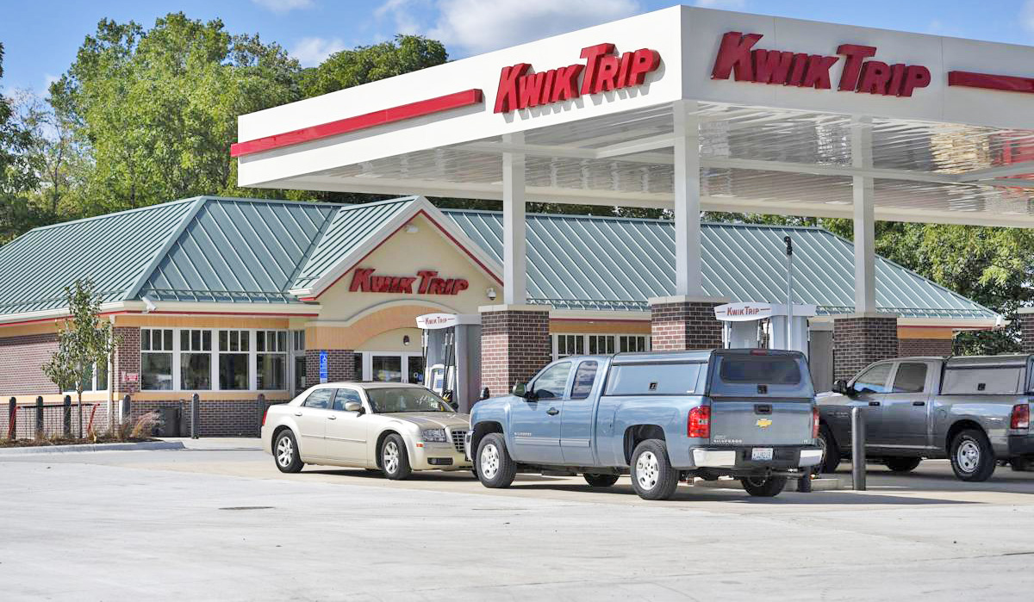
Mission & Vision of a Gas Station
Mission Statement – Kwik Trip
“To serve our customers and community more effectively than anyone else by treating our customers, co-workers, and suppliers as we, personally, would like to be treated and to make a difference in someone's life.”

Slide 24
Mission & Vision of the Church
Mission vs. Vision – Must be CLEAR
A vision statement is like a photograph of your future business, which gives your business shape and direction. What do you want to achieve and be known.
A vision statement provides the direction and describes what the founder wants the organization to achieve/be in the future; it’s more about the “what” the church/business will achieve/be/become. It is different from a mission statement, which describes the purpose of an organization and more about the “how” of a business.

Slide 25
Mission & Vision of the Church
The Importance of Vision – Must MOTIVATE people
Without a vision statement, people will lack motivation to keep going.
If you don’t aim for anything, you might not hit anything. The more specific and clear you are, the better your chances are at seeing your vision turn into reality.
The importance of a vision statement cannot be overlooked; not only does it provide long term direction and guidance, but it also gives you the inspiration and the necessary energy to keep going when you feel lost.
Always keep your vision statement alive by revisiting it regularly and communicating your vision with other members of the team, to inspire and motivate them as well.
“The people perish for lack of vision”

Slide 26
Mission & Vision – Must have COMMITTED people
We need people with…
a conviction, belief, mission,
vision, love, dedication,
energy, plan and hope
We need committed leaders
who see the vision and are
like-mind to be in the mission
Setting the sail
We need people who trust, listen and follow the mission and vision of God, the vision of this church

Slide 27
Mission & Vision of YOUR Church
Do you have a Mission/Vision Statement?
Does it motivate you, is it clear and give you direction and guidance?
Is it simple to understand, achievable and everyone take ownership of it?
Does it have a Big Picture in mind
Do you have committed people to the mission/vision
A “vision” begins with he end in mind

Slide 28
Setting the Sail – Your Church Mission & Vision
What do you want to be known?
What do you want to achieve?
How will you go about doing it?
When will it be done?
Who will do it?

Slide 29
Let’s Review Your Mission and Vision
Mission: "To Love, Nurture, Growth, and Witness in the name of our Lord Jesus Christ"
Mission: "To live out our faith through Love, Growth and Services in (the name of our Lord) Jesus Christ"

Slide 30
What is your church’s mission & vision
Vision: (values?, how?)
I. To be a LOVING (congregation?) mean that we are committed ourselves to respecting, caring, sharing, helping, and visiting others.
To live out our faith through love means we are committed to respect, care, share, help and visit others

Slide 31
What is your church’s mission & vision
Vision: (values?, how?)
I. II. To be a NURTURING congregation mean we are committed to teaching, praising, communicating and leading others.
To live out our faith through growth means we are committed to learning/Bible study, worshiping, prayer, fellowship, and teaching others.

Slide 32
What is your church’s mission & vision
Vision:
III. To be a GROWING congregation mean we are committed to prayer, focusing for growth in membership through evangelism, advertising, and marketing the grace of God in our community.
IV. To be a WITNESSING c ongregation mean we are committed to diversity, intercultural, and witness to all God's people here and around the world.
Combine these two to ONE = SERVICES

Slide 33
What is your church’s mission & vision
Vision:
III. & VI
To live out our faith through services means we are committed to (1) evangelism, (2) outreach ministries, (3) engaging in and supporting mission and mission projects locally, nationally and globally, (4) call, train and deploy people to serve, (5) branching out or starting new ministries – becoming selfless, giving our time, talent and treasure on behalf of Jesus Christ as his representative in the world

Slide 34
Final Thoughts: Mission and Vision
Your church ministry plan should derive from your Mission and Vision Statement.
Each of your church’s vision involves with planning, strategies, actions, goals and people who will commit to it.
Simply has a vision will accomplish nothing. You must have plans, strategies, actions, goal and people to achieve it.

Slide 35
We are here to support you
Your Mission & Vision

